Slide 1
Sentiment Analysis Using BERT and Multi-Instance Learning
Pablo Restrepo
Iryna Burak
April 27, 2020

Slide 2
Presentation Overview
Project Goal: What are we going to do?
Motivation: Why is the project important?
Tools: Which tools and techniques are we going to use?
Methodology: How are we going to do it?
Evaluation: How are we going to measure our results?
Plan for the next two weeks.
2

Slide 3

1. Project Goal: What are we going to do?
Develop a domain specific sentiment analysis model to predict sentence-level sentiment on social media comments on organic food products.
3

Slide 4
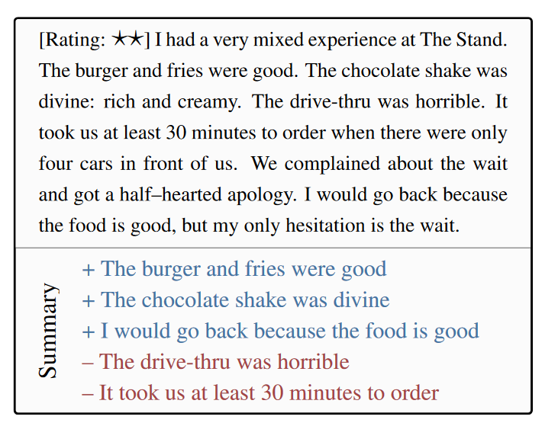
1. Project Goal: What are we going to do?
Example:
As a whole, the review conveys negative sentiment, but aspects of the reviewer’s experience were clearly positive.
This goes largely unnoticed when focusing solely on the review’s overall rating.
4

Slide 5
2. Motivation: Why is the project important?
Coarse-grained document-level annotations are relatively easy to obtain due to the widespread use of opinion grading interfaces (e.g., star ratings ac-companying reviews), but the acquisition of sentence- or phrase-level sentiment labels remains laborious and expensive.
Sentence- or phrase-level sentiment labels are relevant to opinion mining applications: detecting or summarizing consumer opinions in online product reviews.
For sentiment analysis in the organic food domain, it is useful to have the sentiment labels on a sentence or phrase level.
5

Slide 6
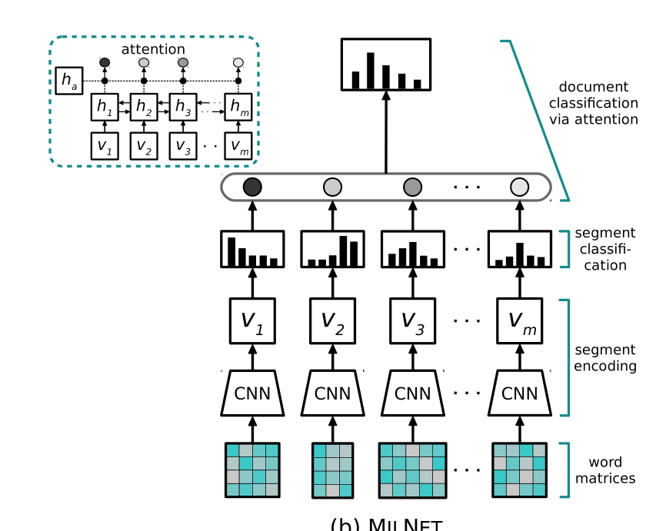

3. Tools: Which tools and techniques are we going to use?
BERT: Bidirectional Encoder Representations from Transformers.
MILNET: Multiple Instance Learning Networks.
6

Slide 7

3. Tools: Which tools and techniques are we going to use?
Bidirectional Encoder Representations from Transformers (BERT):
Technique for NLP (Natural Language Processing) pre-training developed by Google.
7

Slide 8
3. Tools: Which tools and techniques are we going to use?
MILNET: Multiple Instance Learning Networks:
Deals with problems where labels are associated with groups of instances or bags (documents in our case), while instance labels (segment-level polarities) are unobserved.
An aggregation function is used to combine instance predictions and assign labels on the bag level or to simultaneously infer bag and instance labels.
We will do segment-level sentiment analysis as an instantiation of the latter variant
8

Slide 9
4. Methodology: How are we going to do it?
Classifier: Multiple Instance Learning Network.
Data:
Amazon product reviews containing the keyword "organic" from the categories:
Grocery and Gourmet Food
Health and Personal Care
Beauty
Features: BERT CLS embeddings on sentences.
Fine-tune the model on the Annotated Organic Dataset.
9

Slide 10
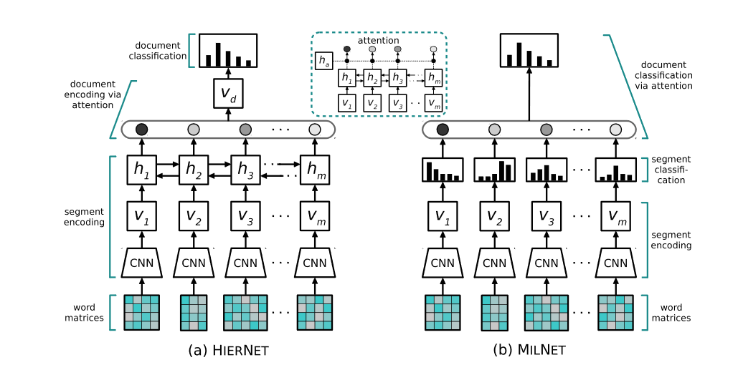
4. Methodology: How are we going to do it?
10

Slide 11
5. Evaluation: How are we going to measure our results?
Performance metrics:
Accuracy.
Micro and Macro F1 scores per category and data split.
Baseline:
SentiWordnet: Lexical resource for opinion mining.
NLTK (Natural Language Toolkit) SentimentAnalyzer: NLTK utility for doing sentiment analysis.
NLTK (Natural Language Toolkit) VADER Sentiment Intensity Analyzer: Lexicon and rule-based sentiment analysis tool.
Unigram and Bigram Classifier using scikit-learn.
11

Slide 12
6. Plan for the next two weeks:
Set Colab environment.
Prepare the data from Amazon.
Get Bert running with our data.
Create the baseline for our data using SentiWordnet, NLTK SentimentAnalyzer, NLTK VADER Sentiment Intensity Analyzer, Unigram and Bigram Classifier using scikit-learn.
12

Slide 13
7. References
https://en.wikipedia.org/wiki/BERT_(language_model)
https://towardsdatascience.com/bert-explained-state-of-the-art-language-model-for-nlp-f8b21a9b6270
https://nlpforhackers.io/sentiment-analysis-intro/
Angelidis S. & Lapata M, Multiple Instance Learning Networks for Fine-Grained Sentiment Analysis, Institute for Language, Cognition and ComputationSchool of Informatics, University of Edinburgh.
13

